Slide 1
Single Stage Vs Staged Corrections for Complex Tetralogy of Fallot
“Rationales in Contemporary practice”
Suresh Rao
Lead Pediatric & Congenital Heart Surgeon
Director, Children’s Heart Centre
Kokilaben Dhirubhai Ambani Hospital, Mumbai, India

Slide 2
No Disclosures

Slide 3
Tetralogy of Fallot
Commonest Cyanotic Congenital Heart Defect
First Cyanotic Heart problem to be palliated and corrected
Surgical outcomes are excellent with perioperative mortality ~1%
Long term survival well into adulthood in most patients
Close to a 70 year follow up…….

Slide 4
When is TOF repaired today?
3- 6 months
6-8 kgs
Neonate………Selected with an indication

Slide 5
Repair of Tertalogy of Fallot
Intracardiac Repair
Transatrial Closure of the Large VSD
RVOT Resection / Pulmonary Valvotomy / Valve sparing options if possible
If the PV annulus is small …. Transannular Patch with treated autologous pericardium
Interrupt any shunt present
Close the PFO or leave it open
Sinus Rhythm
No tricuspid Valve Regurgitation
RV systolic pressure less than 2/3 systemic…. Around half

Slide 6
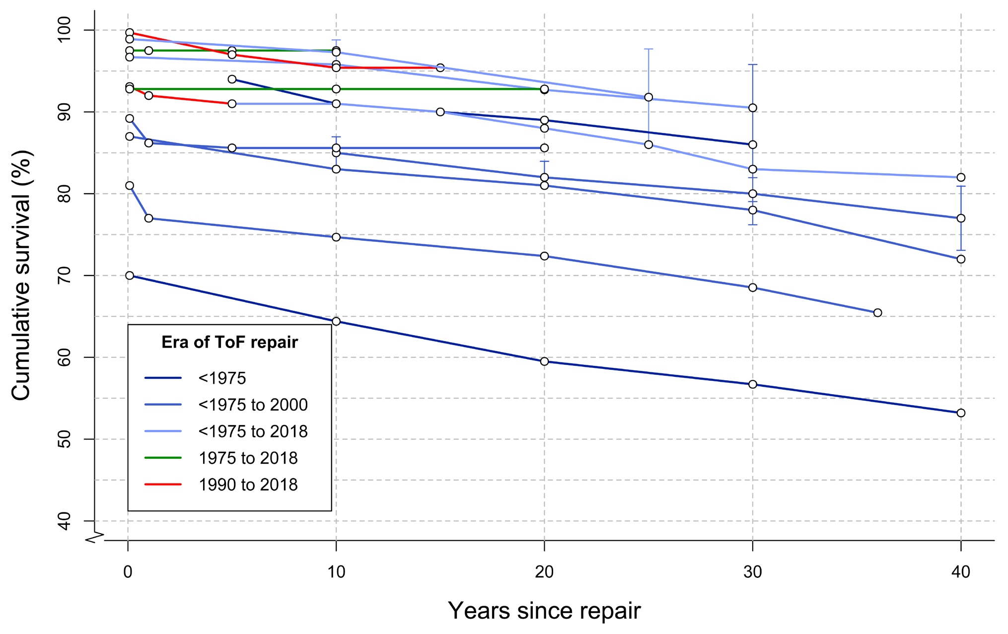
Outcomes of Single staged Repair
F1000Research 2019, 8(F1000 Faculty Rev):1530

Slide 7
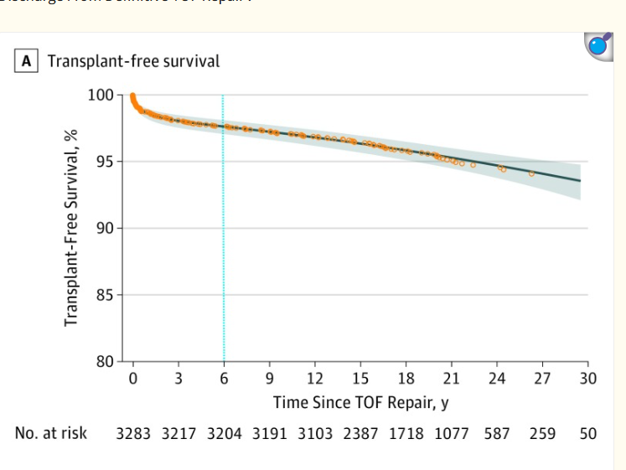
. 2018 Dec 19;4(1):34–41
. 2018 Dec 19;4(1):34–41
. 2018 Dec 19;4(1):34–41
JAMA Cardiol. 2018 Dec 19;4(1):34–41

Slide 8
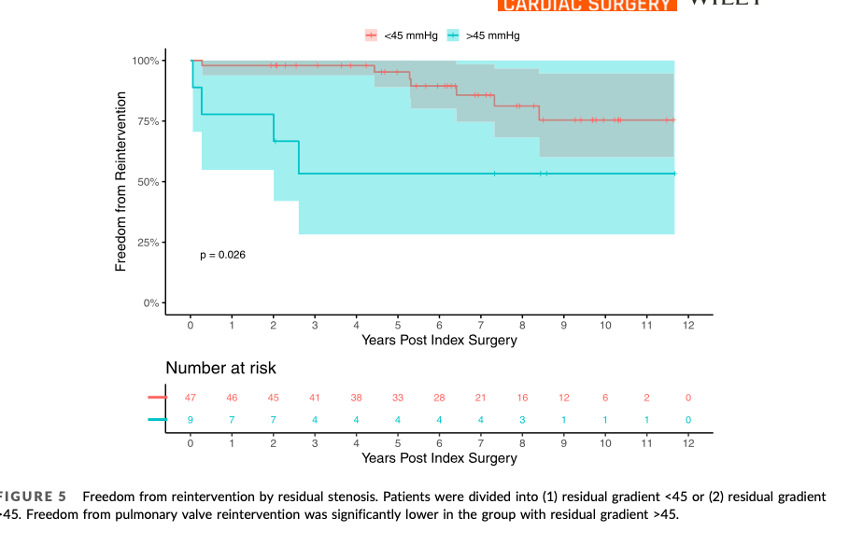
Reviewing the midterm outcomes of our expanded indication of VS procedure for complete TOF repair, intraoperative decision to convert to transannular patch is warranted if intraoperative post- procedure TEE PG is greater than 45 mmHg or RV pressure is higher than half of the systemic pressure to prevent reintervention.
J Card Surg. 2022;37:5144–5152.

Slide 9
What is “Complex” Tetralogy of Fallot
Tetralogy in Neonates
Tetralogy of Fallot with Multiple VSD
Tetralogy of Fallot with Anomalous Coronary Artery crossing RVOT
Tetralogy with Pulmonary Valve Atresia with MAPCAS and hypoplastic Branch PAs
Tetralogy of Fallot with AVSD / ALCAPA/ or other associated anomalies
Tetralogy of Fallot with Absent Pulmonary Valve Syndrome
Tetralogy of Fallot with Restrictive VSD
Tetralogy of Fallot with borderline MV
Residual Lesions after Tetralogy Repair: PR/TR/RVOTO/LPA origin stenosis/CHB

Slide 10
Why Staged repair?
High Risk Groups
Prematurity
Symptomatic Neonates
Unfavourable / Complex Anatomy: Hypoplastic Pas /AVSD
Comorbities and Syndromes
Anamolous LAD crossing RVOT

Slide 11
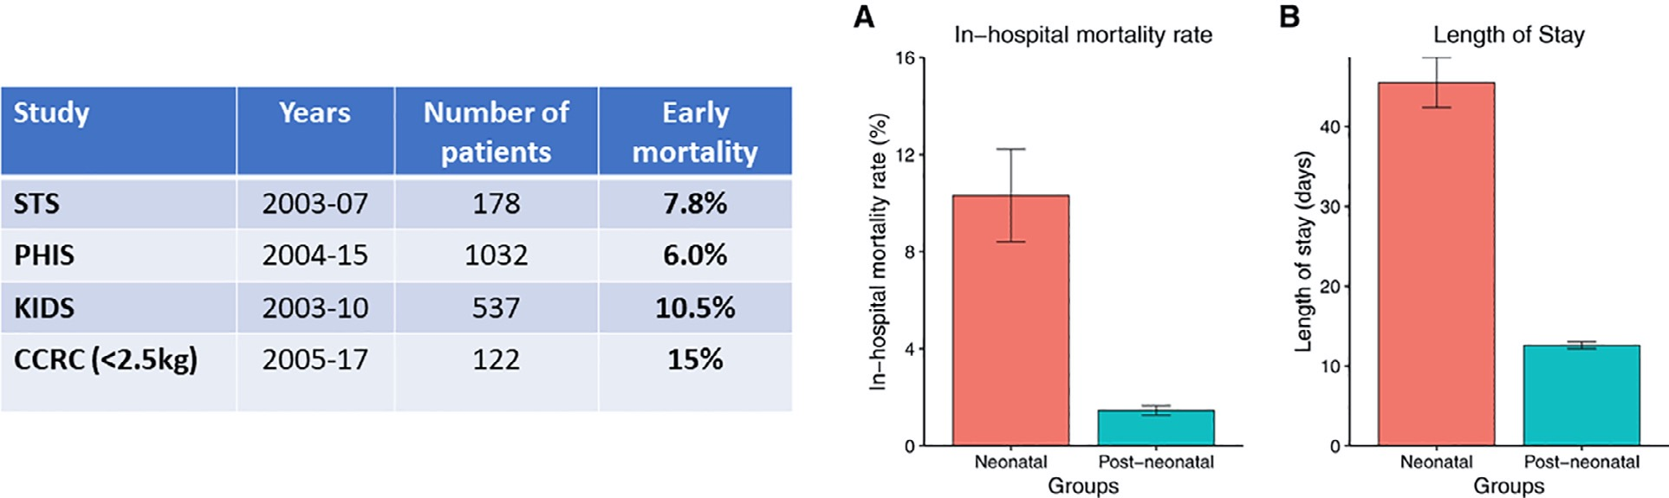
Results of Neonatal TOF Repair
Seminars in Thoracic and Cardiovascular Surgery: Pediatric Cardiac Surgery Annual Volume 24, Number C 79

Slide 12
Ann Thorac Surg.2010;90(3):813-820

Slide 13
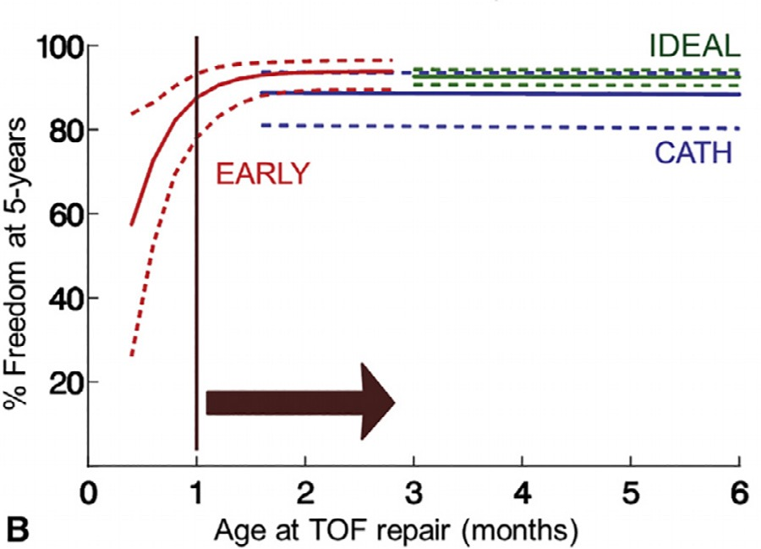
The relationship between age at repair and the need for reintervention.

Slide 14
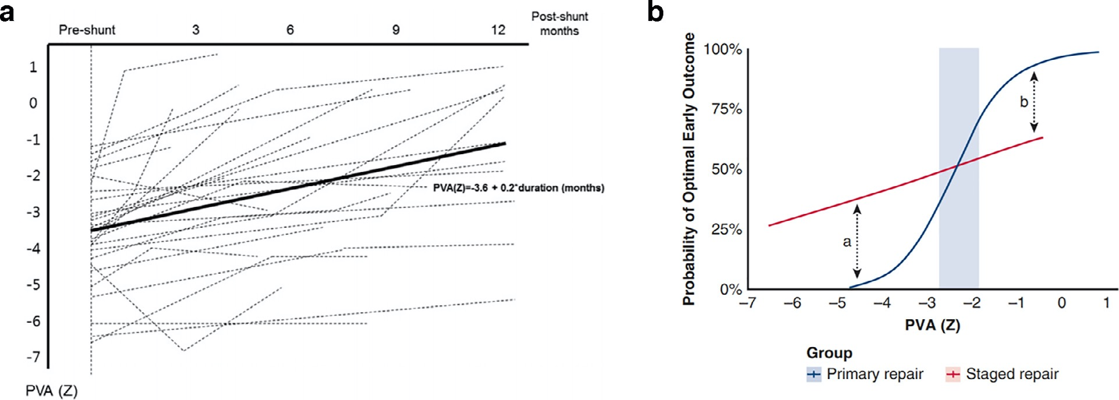
Seminars in Thoracic and Cardiovascular Surgery: Pediatric Cardiac Surgery Annual Volume 24, Number C 81

Slide 15

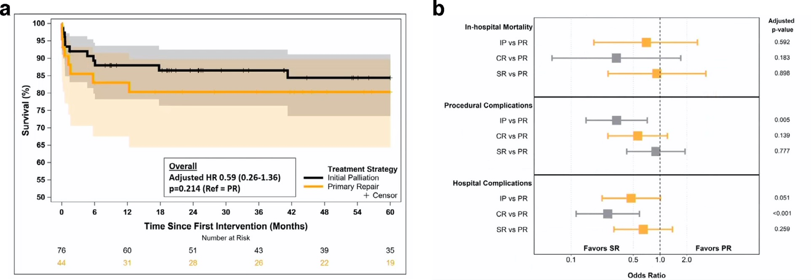
Semin Thorac Cardiovasc Surg Pediatr Card Surg Ann 24:77–84
Comparison of outcomes for repair vs palliation of ToF in neonates under 2.5 kg
Semin Thorac Cardiovasc Surg Pediatr Card Surg Ann 24:77–84

Slide 16
Staging of Repair in TOF
Ist Stage
2nd stage
BT Shunt
Central Shunt
Palliative Transannular Patching
PDA stenting
RVOT stenting
Sano shunt
Trans atrial Intracardiac Repair ( VSD Closure with RVOT resection)
Trans atrial/Transpulmonary Repair with PV conservation
Transatrial Repair with RVOT patch / PV conservation
Transatrial Reapir with Transannular patch with / without monocusp
Intracardiac Repair with Double barrelled RVOT
Intracardiac Repair with RV-PA conduit
One stage Unifocalisation with ICR and conduit

Slide 17
Reasons for staging
Anatomy: Hypoplastic branch pulmonary arteries / AVSD
Major Anomalous coronary artery crossing RVOT near PV annulus
Extreme hypertrophy of RV, Near Pulmonary atresia and deep cyanosis causing “Restrictive RV Physiology” post repair
Borderline Mitral Valve and Left Ventricle

Slide 18
What does Staging do?
Increases Antegrade Pulmonary Blood Flow, promotes intrapulmonary vascular development
Promotes growth of branch pulmonary arteries
Reduces Hypoxia, improves arterial saturations and reduces hematocrit
Increased Pulmonary flow promotes growth of MV and loads the left ventricle
Buys time for repair with a better and more favorable anatomy in a bigger child

Slide 19
Methods of staging
BT Shunt
Central Shunt
Palliative transanular patch
Sano Shunt/RV-PA conduit
PDA stent
RVOT Stent
Intracardiac Repair with fenestrated VSD patch

Slide 20
Place of BT shunt in current ERA
Indications for a Shunt are reducing with improvement in Transcatheter interventions
If anatomy does not permit Stenting (PDA or RVOT)
Overflow
Low diastolic pressure …. Coronary ischemia
“The evidence suggests that we should be striving toward a management paradigm in which the BT shunt no longer has a role in the management of ToF and this approach is summarized” NEONATES
How and When Should Tetralogy of Fallot be Palliated Prior to Complete Repair?
David J. Barron, FRCS(CT), and Anusha Jegatheeswaran, MD, PhD
Semin Thorac Cardiovasc Surg Pediatr Card Surg Ann 24:77–84 Crown Copyright © 2021

Slide 21
Current Practice of neonatal BT Shunt
Median sternotomy : 3.5 mm PTFE shunt
With or without CPB
Keep the purse strings and shift to ICU with open sternum
Close chest after 24 hrs if there is no issue
Low threshold for unblocking of shunt / ECMO in ICU

Slide 22
Side to side Aorto –PTFE central shunt
Aorto Pulmonary Shunt with PTFE graft
Controlled PBF
Ensures growth of both Pas
Less systemic steal
N=16
Biventricular correction in 10
Ann Thorac Surg 1998;65:(515– 6) / Ann Thorac Surg 2011;92:(1476–82)

Slide 23
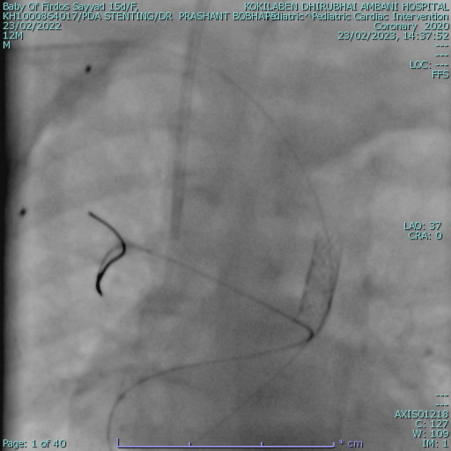
PDA Stent for TOF Pulmonary Atresia
Keeps PDA patent
Increases Pulmonary Blood Flow
Improves saturations
Promotes growth of Pulmonary arteries
Anatomy should be suitable
Migration / Embolisation
LPA jailing / Reinterventions
Flooding of lungs
Lower Diastolic pressure

Slide 24
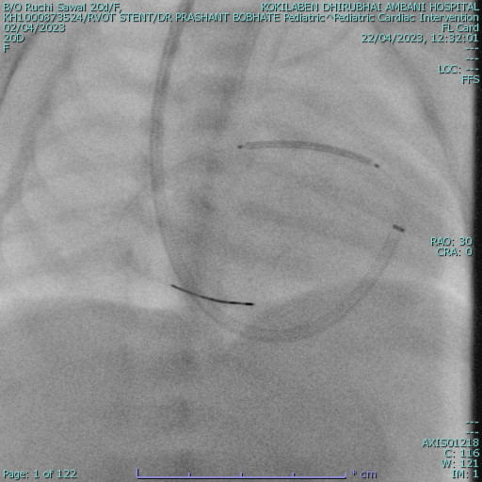
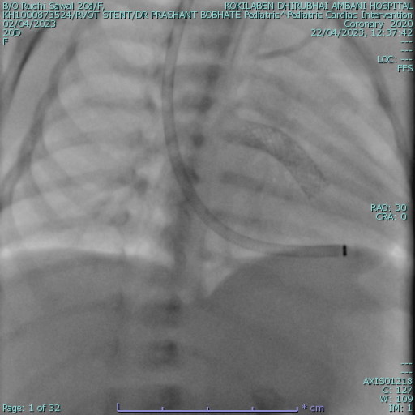
RVOT Stent
Physiological Palliation: Venous blood to PAs
No diastolic Run Off
Antegrade flow to both lungs: Improves Saturations markedly
Dilatable
NO CPB
Shorter ICU Stay
Good Mode of Definitive palliation
Makes corrective surgery more challenging
(VSD Closure and RVOT resection)
Embeds into conal septum and RV free wall muscle
? More fibrosis / Arrthythmias
More or less commits to a TAP

Slide 25
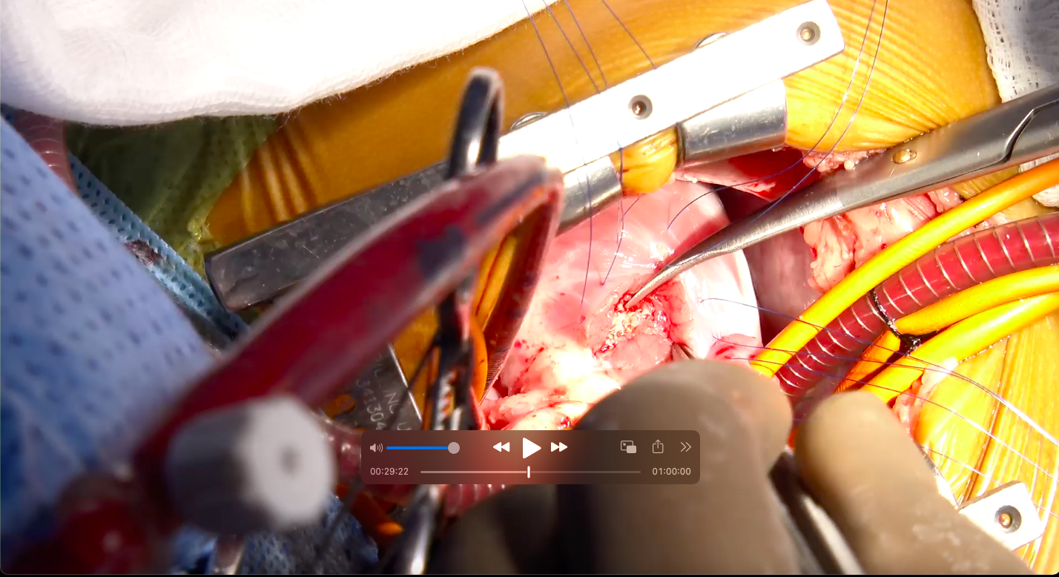

Slide 26
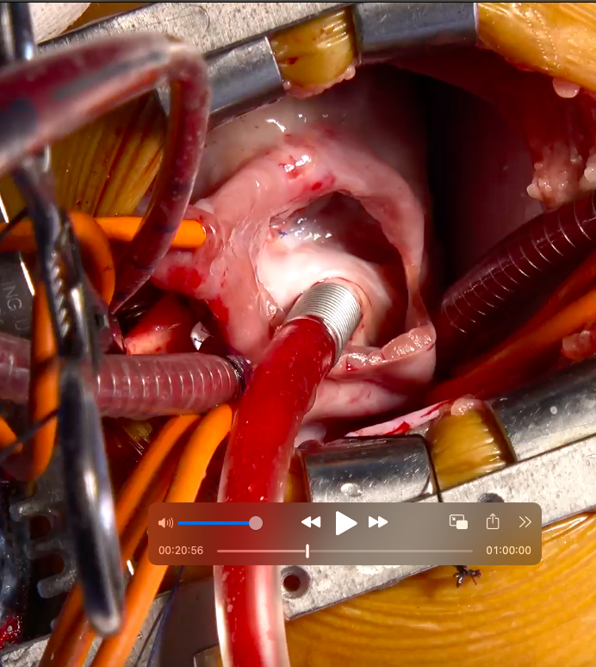
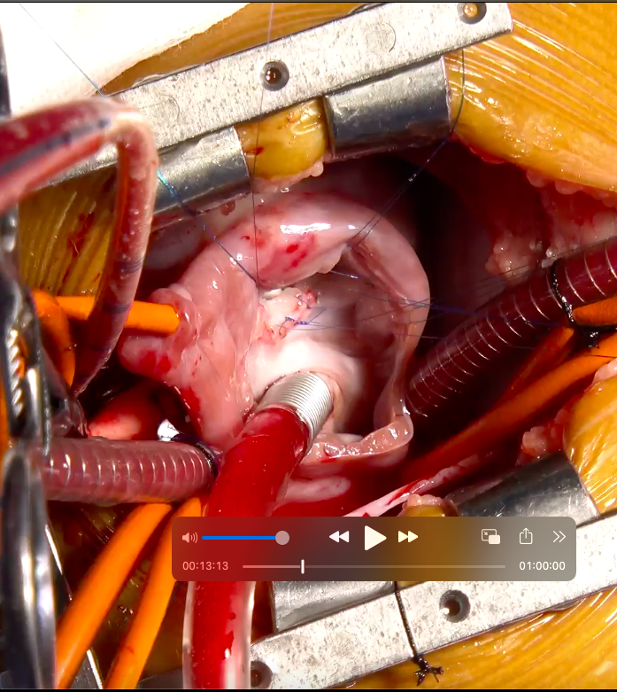

Slide 27
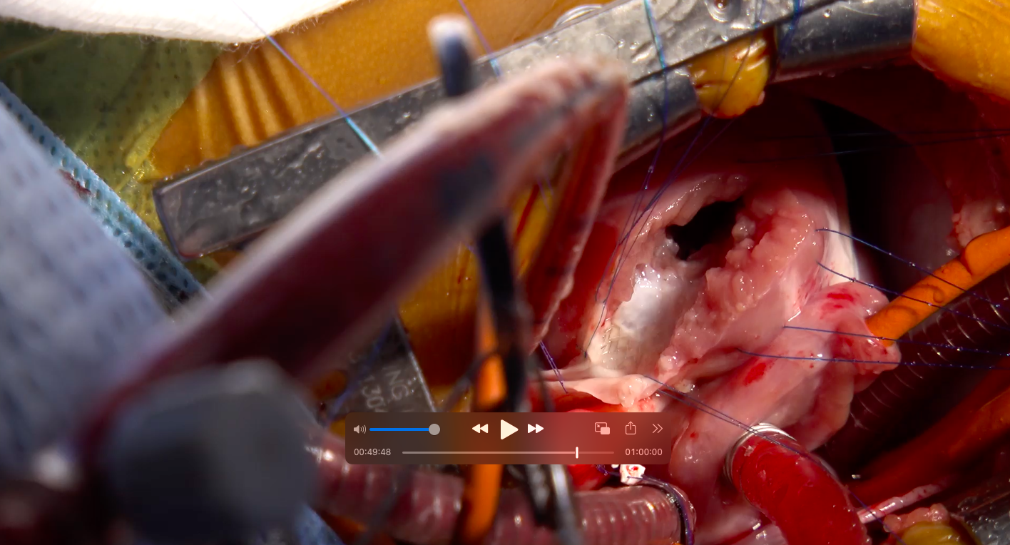
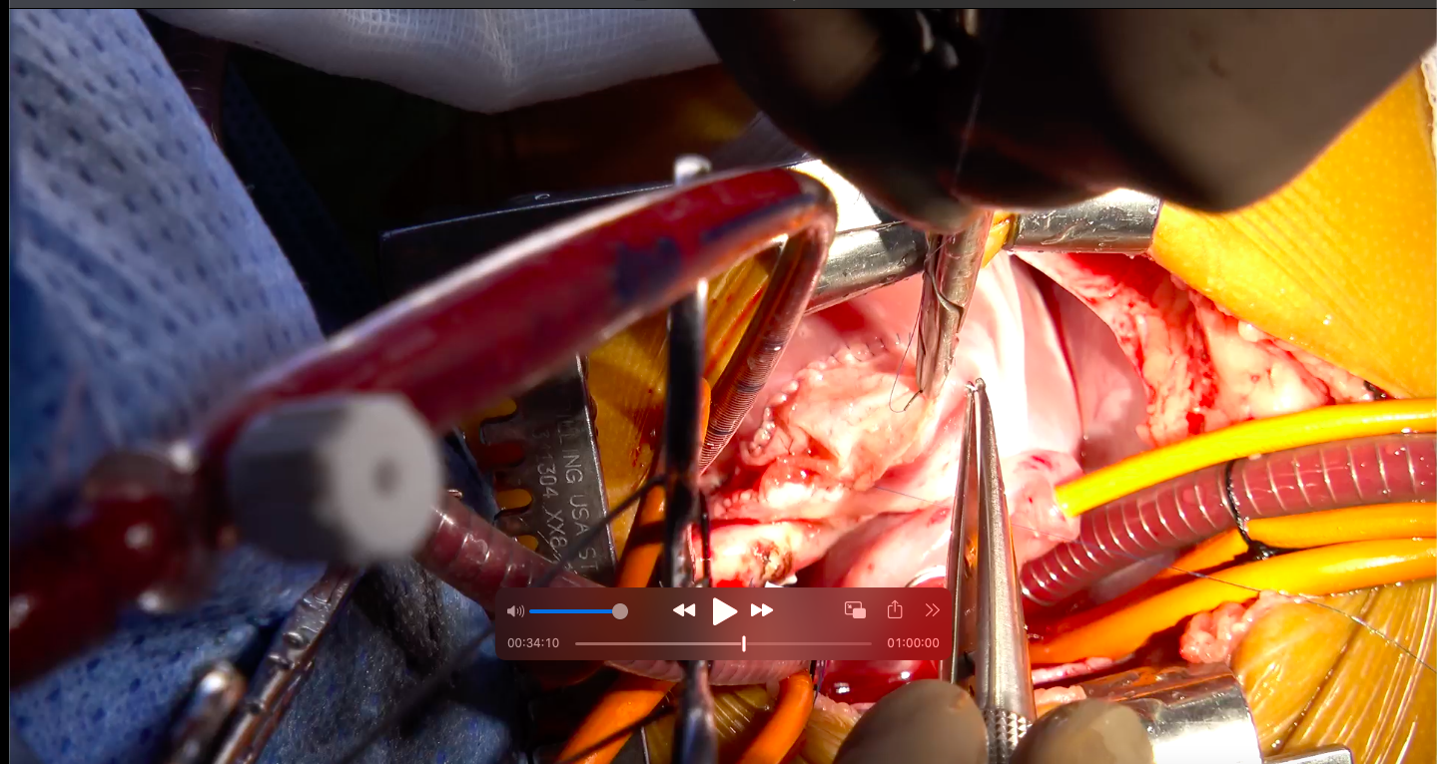

Slide 28
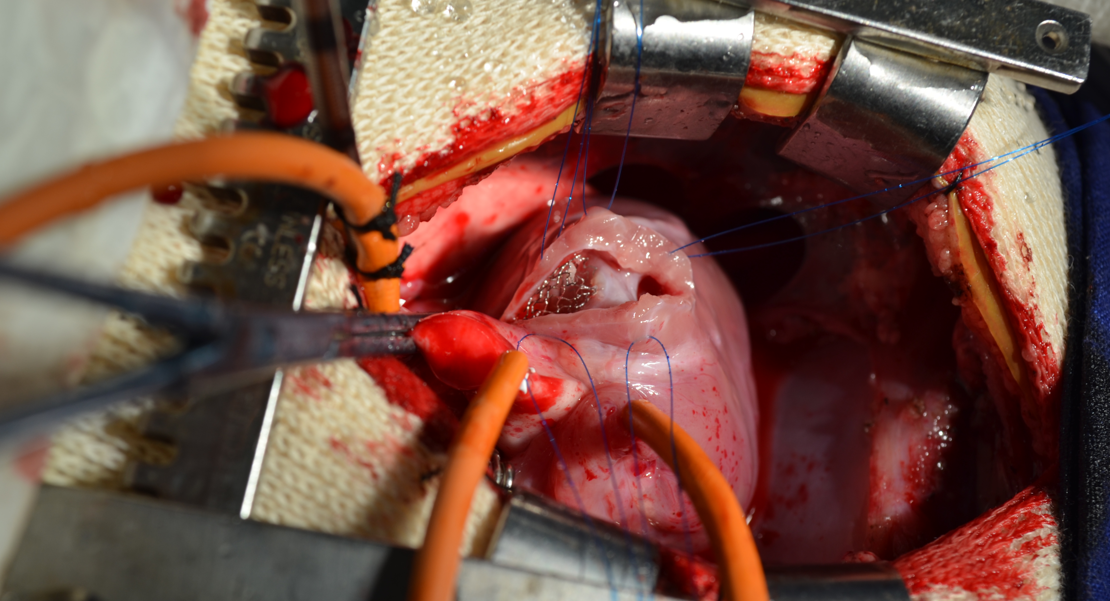

Slide 29
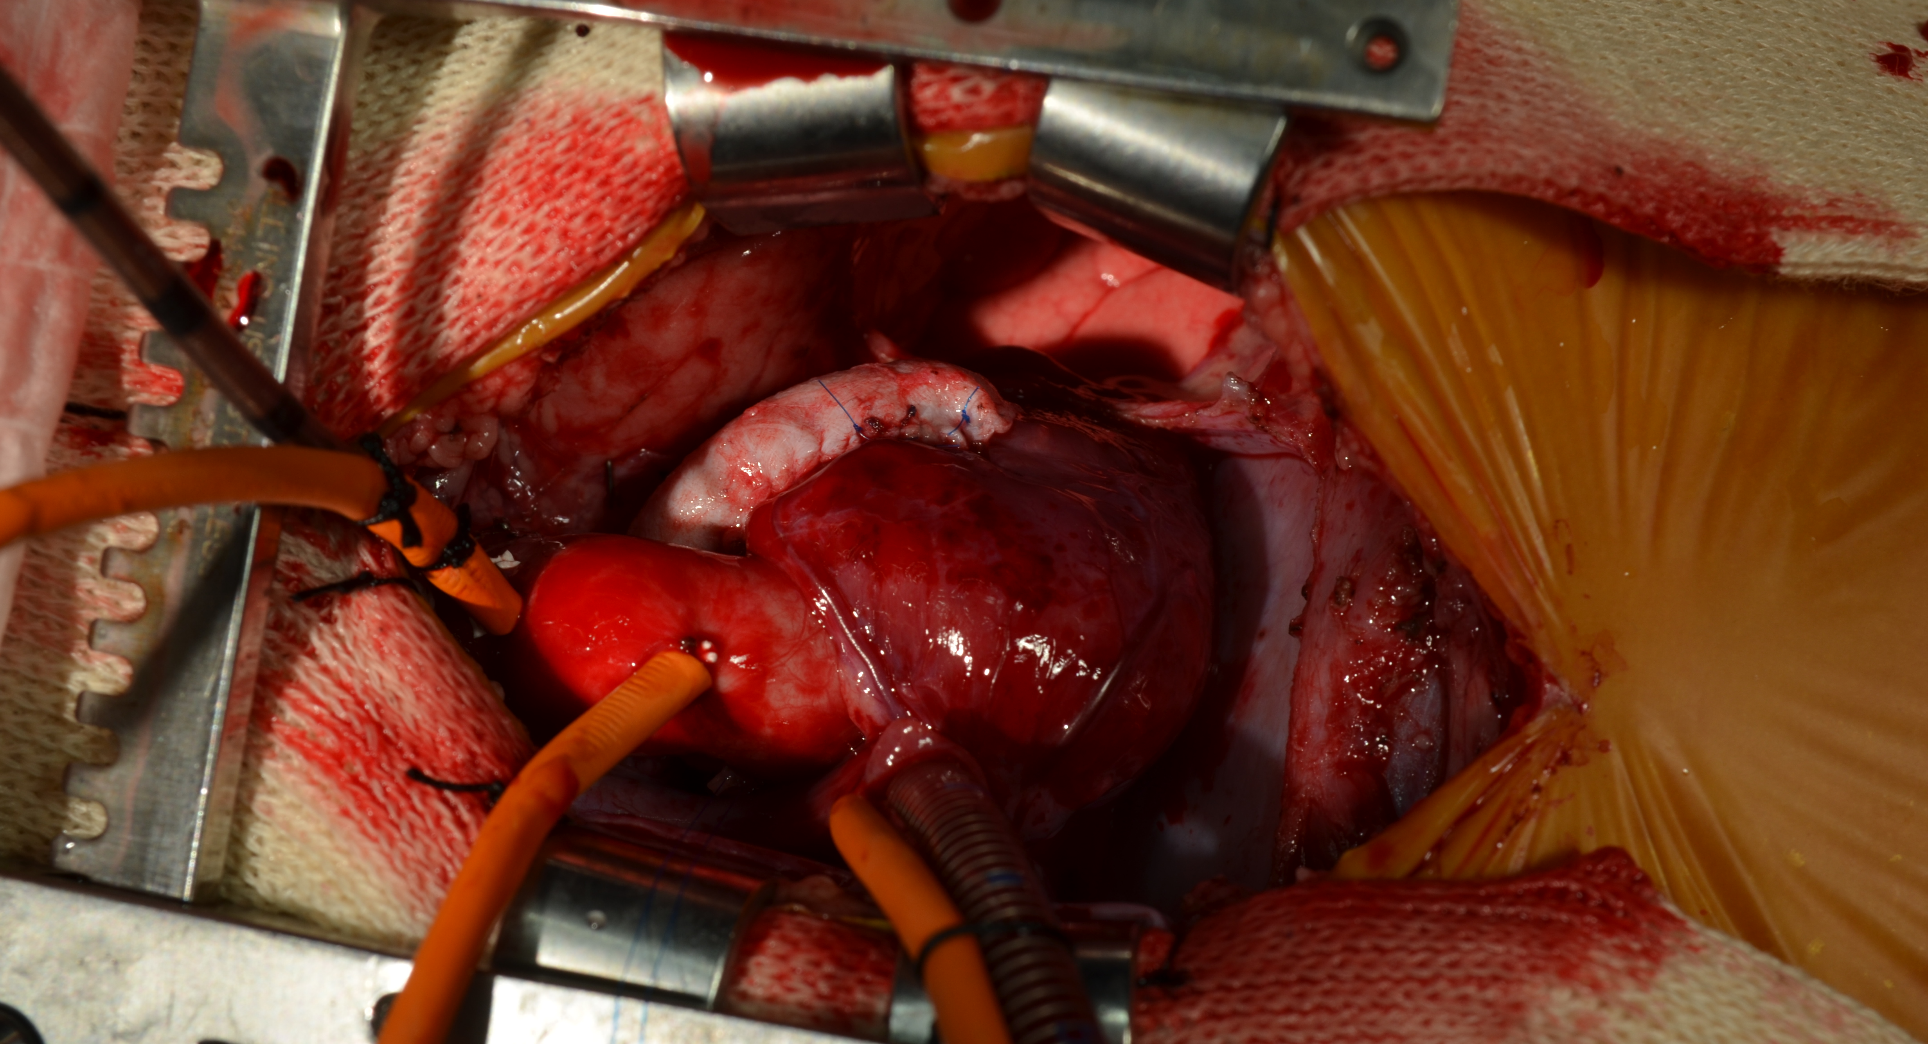

Slide 30
Contraindications to Stents
RVOT Stent
PDA Stent
Very Short Infundibulum
Landing zone unstable
Absence of conal septum….? (R)
Anomalous Coronary artery crossing RVOT….(R)
Access Issues in very small babies
Long Tortous PDA
Proximal PA stenosis
Inadequate Expertise

Slide 31
Does staging complicate Complete Repair
YES
Dissection of PDS Stent
Removal of RVOT stent. Embeds into conal septum and rvot free wall
VSD sutures in de- endocardiumised muscle
Transannular patch

Slide 32
Complication of stents
RVOT Stent
PDA Stent
Spells
Stenosis / fracture / perforation
Migration / Slippage
PR
TR – Chordal rupture / injury
Selective PBF
Embeds into RVOT muscle
Acute stenosis / blockage
Stenosis at PA end
Overflow
Jailing of LPA / Selective RPA flow
Interstage mortality

Slide 33
Our Experience in Staging for neonatal TOF 2018-2024
Stents 91 cases
PDA 52
BT Shunt 1
RVOT 39
TOF / PA 27 (6)
SV 25
TOF 39 (17)
Mortality: PDA Stent : 3
2 interstage & 1 after stenting
RVOT stent; No Mortality
Post ICR: 1 Mortality TAP/ LCOS
ICR with TAP: 11
ICR with TAP and LPA Plasty: 5
ICR with Conduit: 5
ICR with double barrel outflow: 1
ICR with Fenestrated VSD: 1

Slide 34
Semin Thorac Cardiovasc Surg Pediatr Card Surg Ann 24:77–84
Semin Thorac Cardiovasc Surg Pediatr Card Surg Ann 24:77–84
Semin Thorac Cardiovasc Surg Pediatr Card Surg Ann 24:77–84

Slide 35
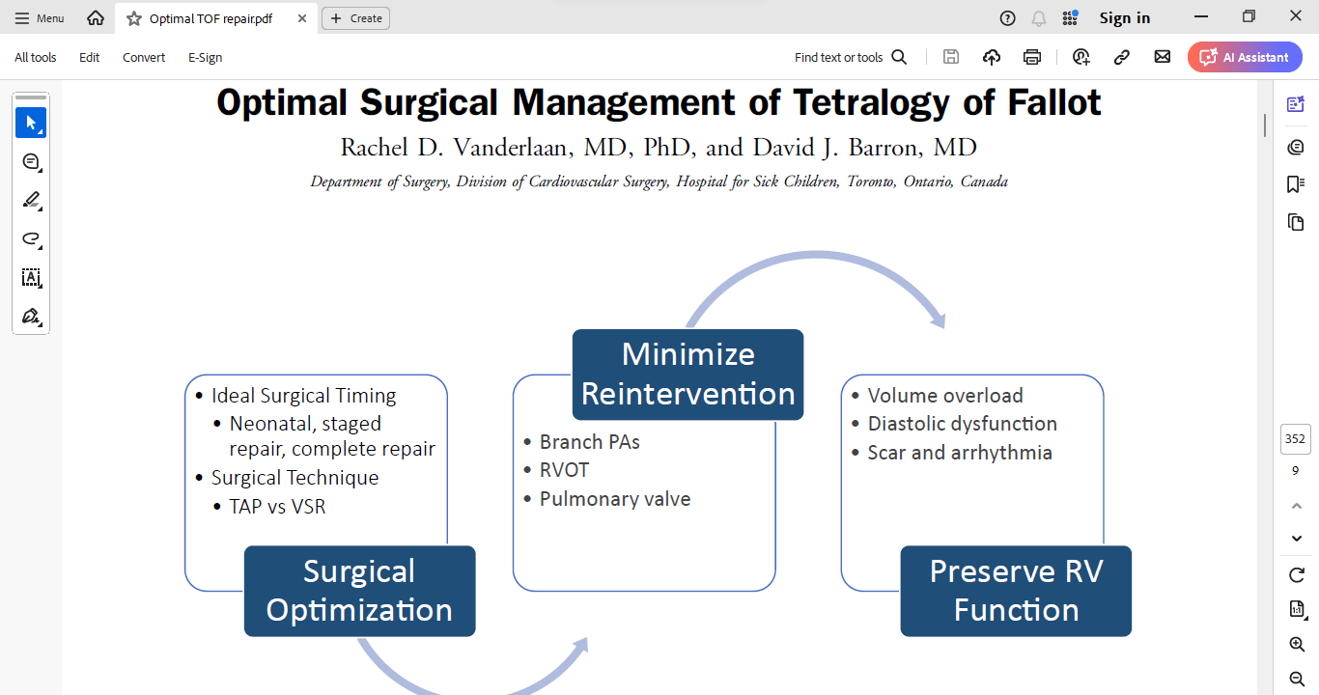
CJC Pediatric and Congenital Heart Disease 2 (2023) 352e360

Slide 36
Overview & Summary
Single staged Repair for TOF is the norm today
Preferrable after the age of 3 months. Best outcomes: 3-9 months
Neonatal repair: With good Anatomy: Unit specific
High risk neonates and very sick children: Stage repair
RVOT stent,, remains the choice of palliation today, in lieu of BT shunt unless there is a contraindication. Even though it slightly complicates the complete repair
The concept of maintaining “RV Health” for the long term takes precedence in dictating the choice of procedures

Slide 37
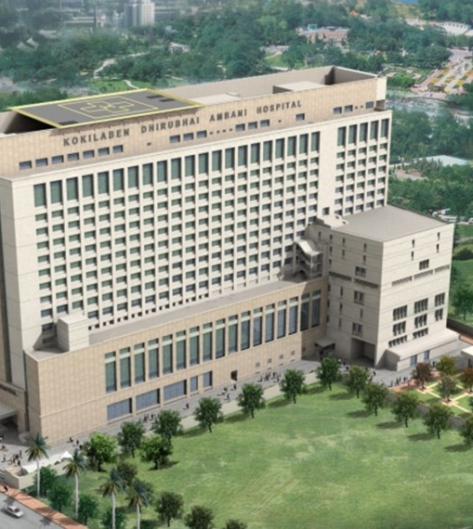


Thank You

